Slide 1


PYTHON-PROJECT ROCK - PAPER -SCISSORES
PRESENTATION BY
Ponnapalli Surendra Varma

Slide 2
Let’s Get Started
Introduction
Objective & Scope Of the Project
Application Tools
Project Design
Flowchart
Testing And Validation
Conclusion
References

Slide 3
INTRODUCTION
This project is a 2D Rock paper scissors developed using Python’s Tkinter library. The "Rock, Paper, Scissors Game" is a simple and interactive desktop application built using Python. It allows users to play the classic game against a computer. The project demonstrates the use of graphical user interfaces (GUIs) and randomisation in Python to create a fun and engaging user experience. Users can select their choice of Rock, Paper, or Scissors, and the computer generates its choice randomly. The result of the game is displayed in a pop-up window

Slide 4
OBJECTIVES AND SCOPE
User-Friendly Interface:
To design a simple and intuitive graphical user interface (GUI) that makes it easy for users of all age groups to play and enjoy the classic "Rock, Paper, Scissors" game.
o To ensure the application is accessible and requires no prior technical knowledge to operate.
Showcasing GUI Development with tkinter: To demonstrate the capabilities of the tkinter library for creating interactive desktop applications.
To provide a practical example of using tkinter components like buttons, labels, and windows to build a real-world project.
Implementation of Game Logic: To integrate simple but effective game logic that follows the standard rules of "Rock, Paper, Scissors."
Enhanced User Experience: o To ensure that the application is responsive, with quick result display and clear feedback on the game's outcome.
To add usability features, such as autoclosing pop-ups, ensuring a seamless gaming experience.

Slide 5
APPLICATION TOOLS
Programming Language
Python: The primary language used for coding game logic, character behaviour and interactions within the Tkinter framework.
Libraries/Packages
Tkinter: The main library for creating is the standard GUI toolkit in Python.
Usage: It is used to create the graphical components of the application, including buttons, labels, windows, and layouts.
Purpose: Pillow is an image processing library in Python that is used for opening, manipulating, and saving image files.
Random: Used to add randomness in enemy behaviour, such as patrol patterns and idle moments.

Slide 6
CSV: Facilitates reading level data from external CSV files, allowing for flexible and scalable level design
Integrated Development Environments (IDEs):
PyCharm: Used for coding, debugging, and managing the project files.
Visual Studio Code: An alternative IDE for quick editing, code testing, and project structuring
Additional Tools:
Button Module: A custom or third-party module for managing button clicks and user interface elements, enhancing the in-game menu and navigation functionality

Slide 7
PROJECT DESIGN
This Rock, Paper, Scissors Game is designed with a user-centric approach, ensuring a visually appealing and interactive experience. The design incorporates key GUI elements to make the application engaging and straightforward to use
Main Window
The main window serves as the central interface where users can interact with the application and make their choices.
Buttons with Images
Users can select their choice (Rock, Paper, or Scissors) by clicking on visually intuitive buttons.
Each button is enhanced with an image representing the choice (rock, paper, or scissors) for better engagement.
Title and Labels
A title is displayed at the top of the window to describe the game purpose ("Rock, Paper, Scissors Game").
Labels below each button provide text descriptions of the options, ensuring accessibility and clarity.

Slide 8
Layout
The buttons and labels are arranged in a grid format, with equal spacing and alignment for a balanced appearance.
The window uses a white background to maintain a clean and professional look, complemented by appropriately colored text and labels.
Secondary Pop-Up Window
After the user makes their selection, the game opens a secondary pop-up window to display the game results.
Result Display : A bold and distinct message highlights the result (Win, Lose, or Tie)
Timed Auto-Close : The pop-up window automatically closes after 5 seconds, returning the user to the main window.

Slide 9
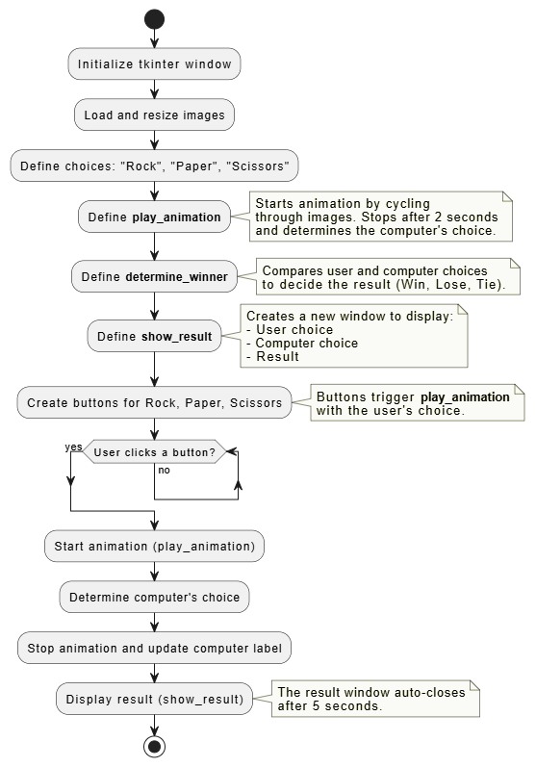
FLOW CHART

Slide 10
Testing & Validation
Unit testing
Integration Testing
System Testing
Manual Testing
Performace Testing
Verifies the functionality of individual components or methods.
Key Areas Tested:
Rock beat Scissores
Scissors beat paper
Paper beat Rock
Ties are correctly identified
Checks how well different components interact with each other.
Key Areas Tested:
Start the game from the welcome screen using_button
Click each choice (rock_button, paper_button, scissors_button).
Validates the entire game workflow to ensure it meets requirements.
Key Areas Tested:
Game Workflow Test the Workflow Start game -> make a choice -> view result -> close result windows.
Game was manually played under various scenarios to identify issues.
Key Areas Tested:
Start the game and explore the interface
Test buttons Start Game hides the Welcome screen
Exit closes the application.
Performance testing assesses the application’s responsiveness and stability.
Key Areas Tested:
Test the animation cycle in play_animation() to ensure it is smooth and stops at correct time.

Slide 11
Conclusion
The Rock, Paper, Scissors game implemented with Tkinter provides a functional and engaging graphical user interface for players. Below is the evaluation and summary
User Interface:
The interface is visually appealing with color-coded buttons and proper labeling.
Images for "Rock," "Paper," and "Scissors" enhance the game's visual appeal and interactivity.
Game Flow:
A clear separation between the welcome screen and the game screen ensures intuitive navigation.
Animation before the result is displayed adds an enjoyable dynamic element to the game.
User Feedback:
A dedicated result window displays outcomes (tie, win, or loss) with both the user's and computer's choices, enhancing clarity.
Auto-closing the result window after 5 seconds keeps the game flow smooth.

Slide 12
Reference
Python Official Documentation:
Standard library references for os, random, and csv modules.
https://docs.python.org/
Freesound.org:
Repository for free sound effects and audio clips.
https://freesound.org/
Clear Code YouTube Channel:
Tutorials on Tkinter game development.
https://www.youtube.com/@CodingWithRuss
Project GitHub Repository:
https://github.com/surendra7438/rock-paper-scissores

